Slide 1
Medical Cost Report
Zhenglei Jiang, Qintian Huang, Sijia Li, Zhangde Song

Slide 2

Dataset
Notes:
Good afternoon, Our team is group 8 and these are our group members. My name is Zhenglei and…..
OK thank you!
As you can see we are a group four and when first thinking about the project ideas, we wanted to use our man power to tackle some real world problems.
Thats’s how we found the medical personal data set from kaggle.
So this is a data set consisting of over 1 thousand patient’s basic information including age, BMI ses wheather they smoke ore not and etc.
And we hope to make sense of these obscure data and try to learn how each patient’s features correlate to his or her medical cost and ultimately build a model that could predict a patient’s medical cost given their basic information.
To approach this, we made quite a few models which we will dive into later.

Slide 3
Dataset introduction
age: age of primary beneficiary
sex: insurance contractor gender, female, male
bmi: Body mass index, providing an understanding of body, weights that are relatively high or low relative to height, objective index of body weight (kg / m ^ 2) using the ratio of height to weight, ideally 18.5 to 24.9
children: Number of children covered by health insurance / Number of dependents
smoker: Smoking
region: the beneficiary's residential area in the US, northeast, southeast, southwest, northwest.
charges: Individual medical costs billed by health insurance

Slide 4
Goals and Approaches
Problem we are trying to solve
Find the best model for predicting medical cost
Approaches
Linear regression
Random forest regressor
K-means clustering
Logistic regression

Slide 5
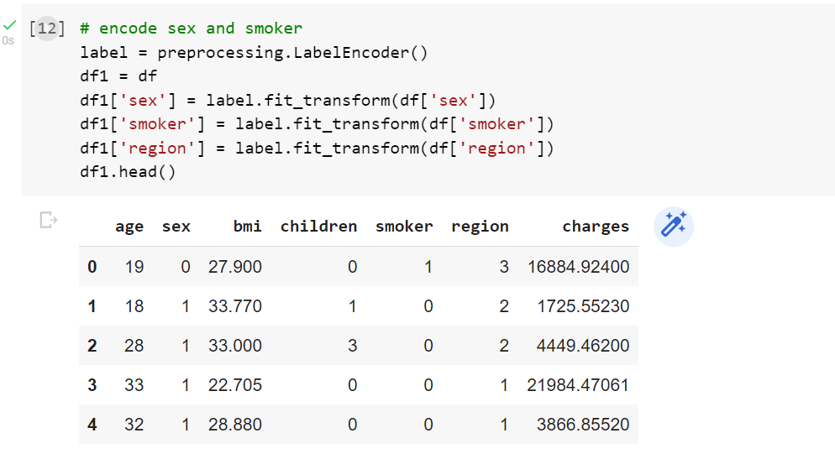
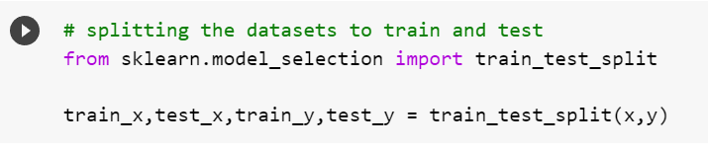
Data Processing
Encoding
Deletions
Train Test split (80 20)
Notes:
The data was first encoded to a machine reconizable formats and null / irrelevant data were cleared out

Slide 6
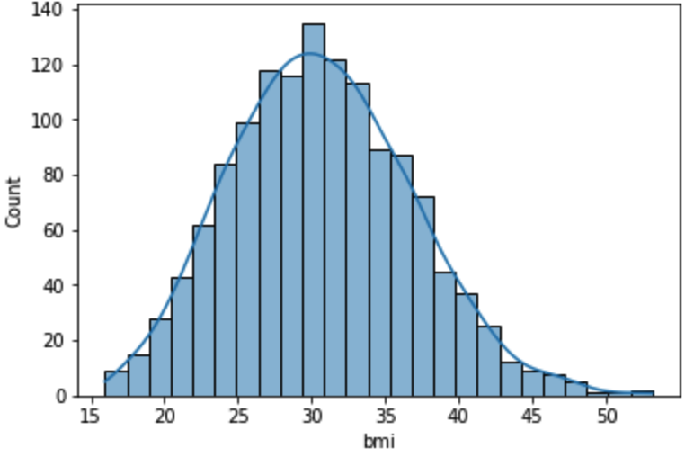
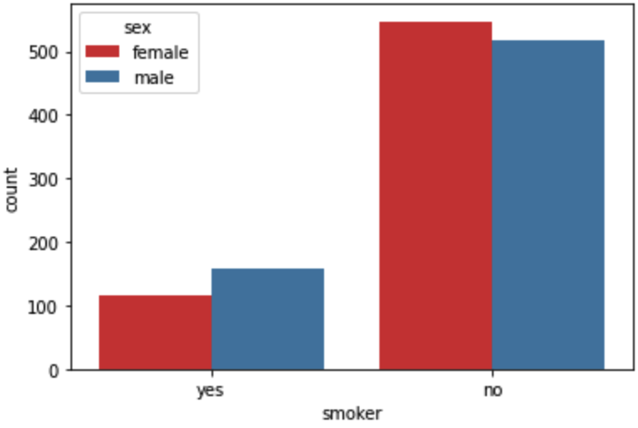
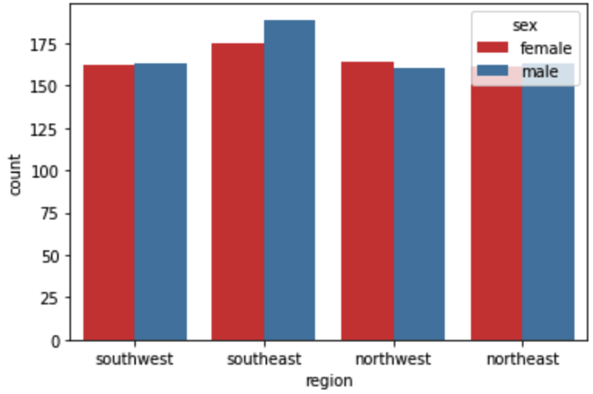
Data Visualization
Distribution of BMI
Distribution of smoker
Distribution of region
Notes:
Now few basic plots were generated
And we could find that in out data set,
Bmi follows a gaussian distribution which indicates a strong correlation between bmi and cost. And this makes bmi an intreasting data to be tracked
A significant medical cost difference between smoker and non smoker which markse smoking an intreasting factor to be tracked
region data is relatively evenlydistributed which indicate that this feature is less likely to have great impact in our modeling

Slide 7
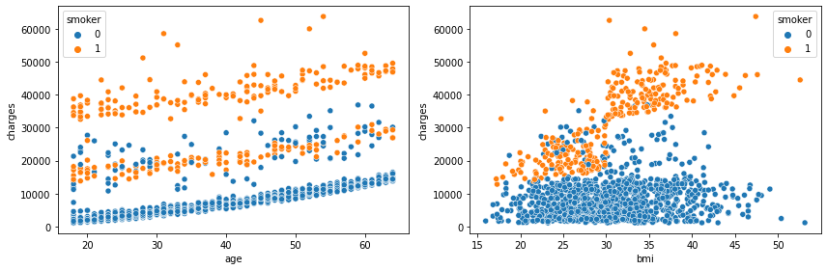
Data Visualization: categorical
Age Vs. Charges & BMI Vs. charges separated by: Smoker
Age Vs. Charges & BMI Vs. charges separated by: Sex
Age Vs. Charges & BMI Vs. charges separated by: Region
Notes:
When further plotted, we find that tere are some kind of clustering correlation between bmi and age to medical cost,
To testfy this, we ran a decision tree importance analysis over all these features

Slide 8
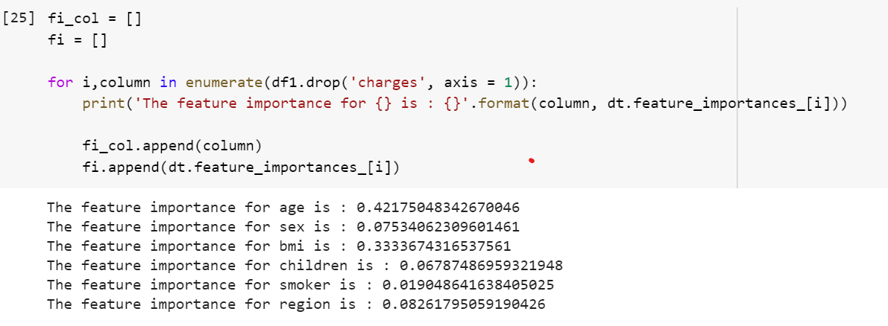
Importance
Age Vs. Charges & BMI Vs. charges separated by: Smoker
Features are shuffled n times and the model refitted to estimate the importance of it
In the below case, age (0.42) and bmi (0.33) are the values strongly related to charges
Notes:
And here are the result:
We find that in deed that age and bmi scored 0.42 and 0.33 respectively and both significantly higher than all other features.
This is why were decided to start our experiment with linear regression model for the bmi and age features.

Slide 9
Linear Regression
 | Variables | Equation | Results | R^2 Value
Simple LR | Age | y = ax+b | y = (192.37157976 * x) + 9455.3300572 | 0.04
Simple LR | BMI | y = ax+b | y = (864.12452383 * x) -10471.21685794 | 0.11
Multiple LR | Age, BMI | y = a1x1 + a2x2 + b | y = 172.5286568 * x1 - 835.17704282 * x2 -16151.04774268 | 0.15
Multiple LR | Age, BMI, Smoker | y = a1x1 + a2x2 + a3x3+ b | y = 320.0978024 * x1 - -22.52480488x2 + 0 * x3 + -3738.48465202 | 0.76
Polynomial LR | Age, BMI, Smoker | y = a1x1^n + a2x2^n + a3x3^n+ b | / | 0.98

Slide 10
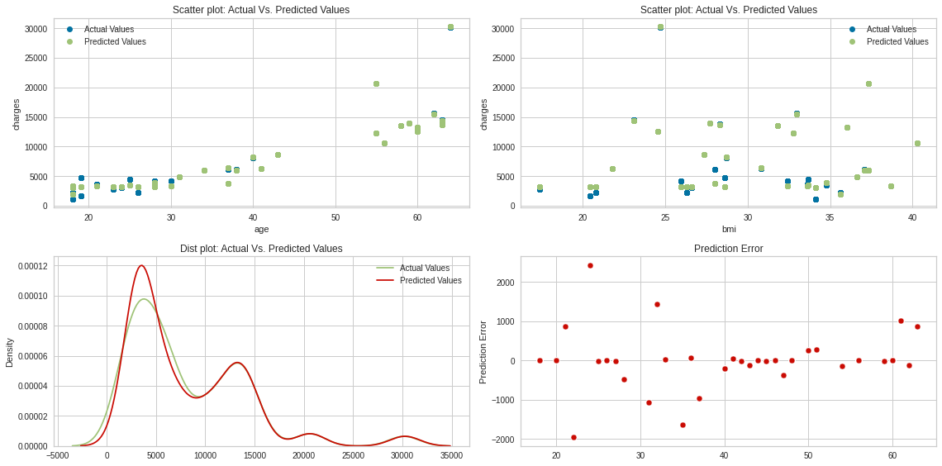
Actual VS. Predicted, Predicted Error

Slide 11
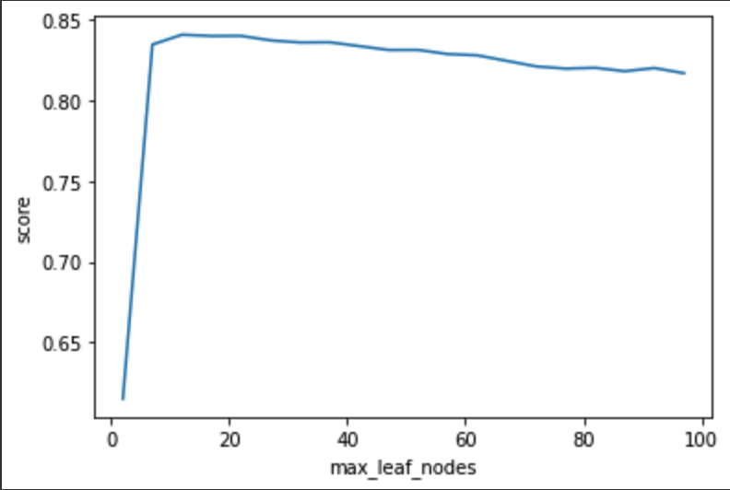
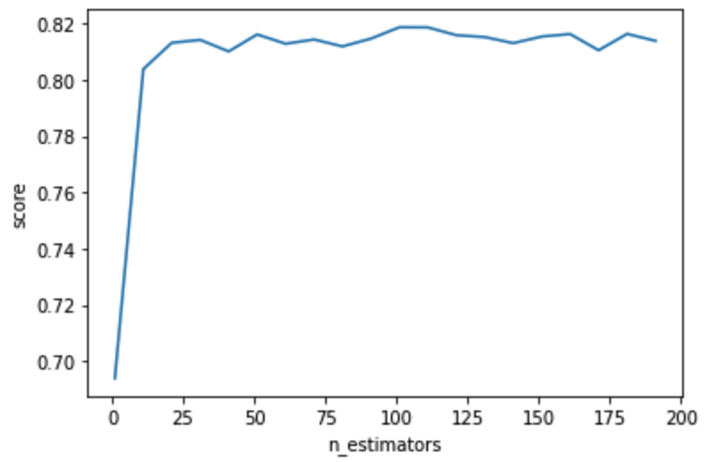
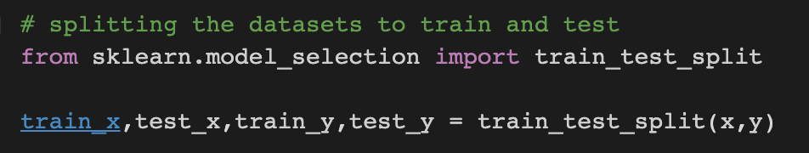
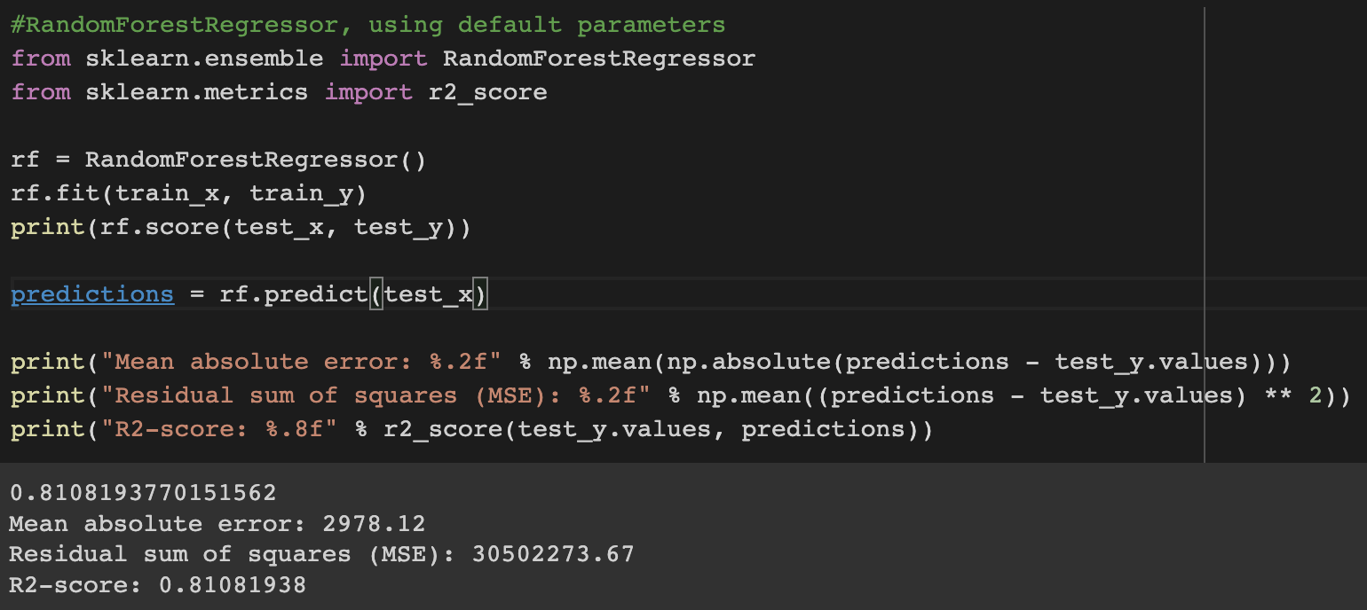
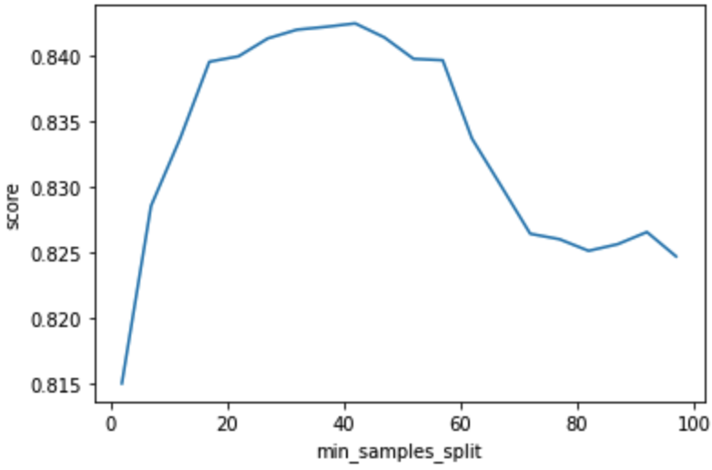
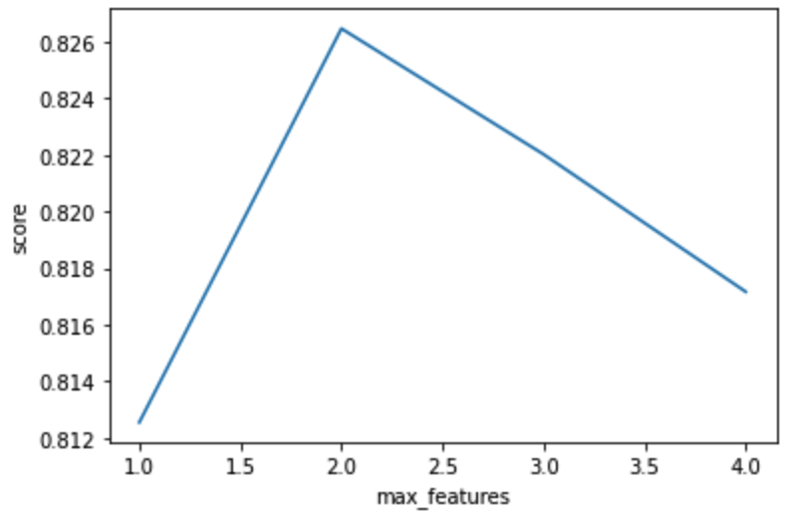
Random Forest Regression - Hyperparameter Tuning

Slide 12
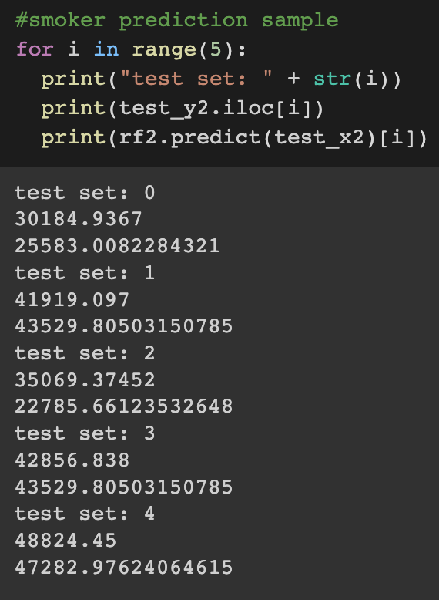
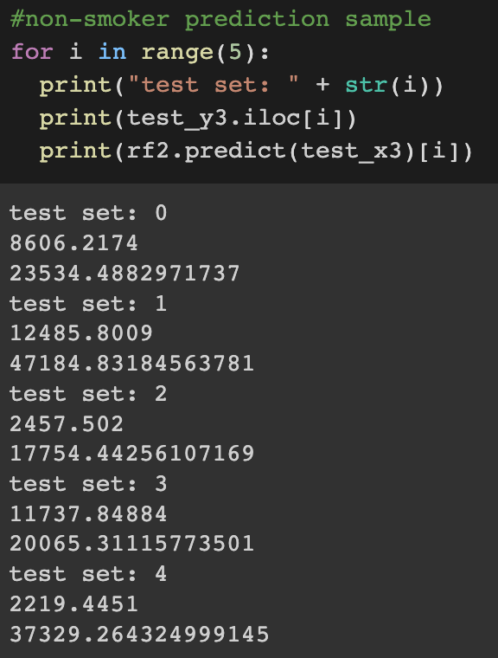
RFRegressor - Sample of Prediction
Intuitively, the model works better for smoker
On the other hand, the error for non-smoker is more obvious
May have over fitting or under fitting problem

Slide 13
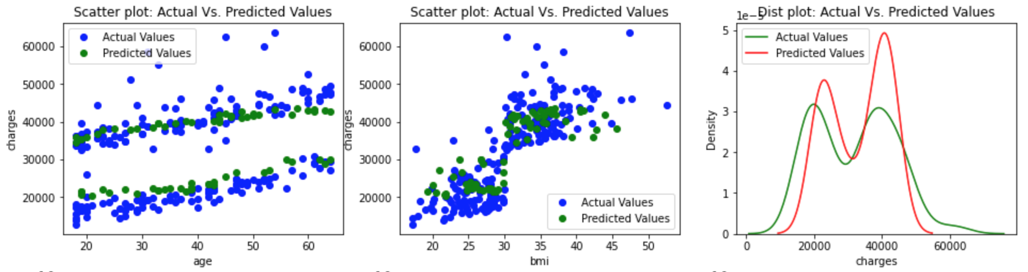
Result Visualization, Actual VS. Predicted

Slide 14
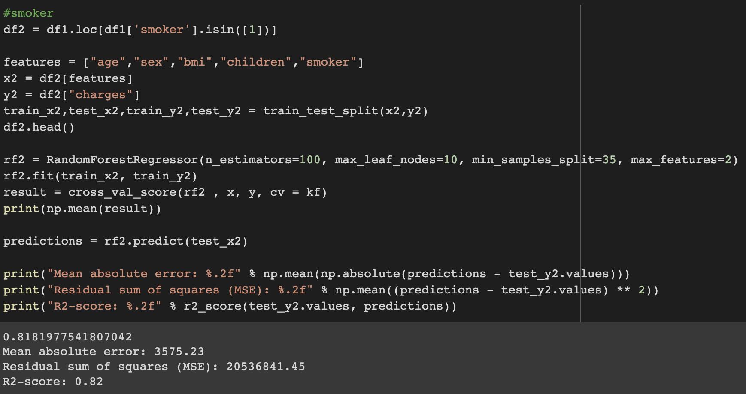
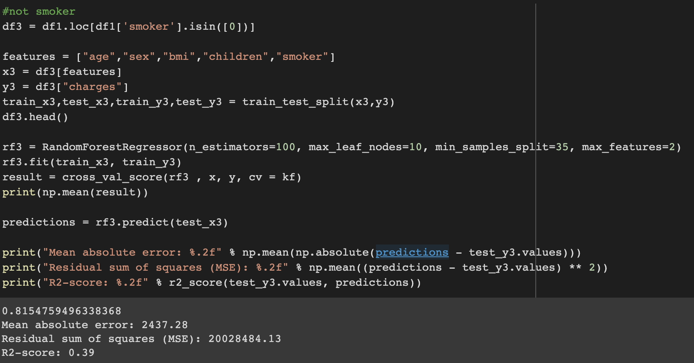
RandomForestRegressor - Predict Smoker/Non-Smoker
with 5 Fold Cross Validation
Though there is large difference in R2-score, 5 cv fold shows an average level of performance

Slide 15
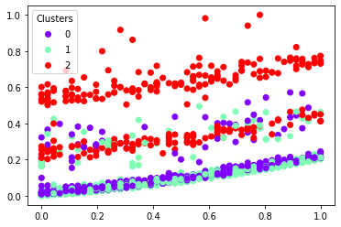
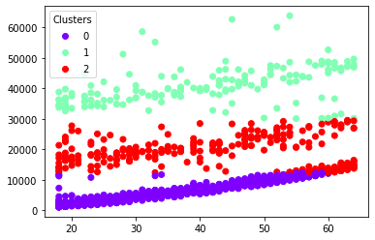
K-Means Clustering - 300_iter
With Normalization(0,1)
0: [36, 6296]
1: [40, 40761]
2: [45, 18505]

Slide 16
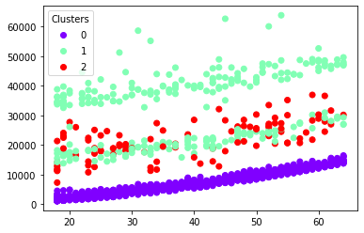
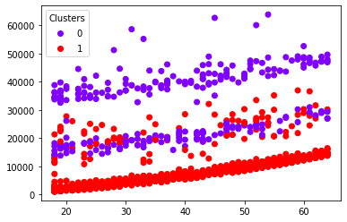
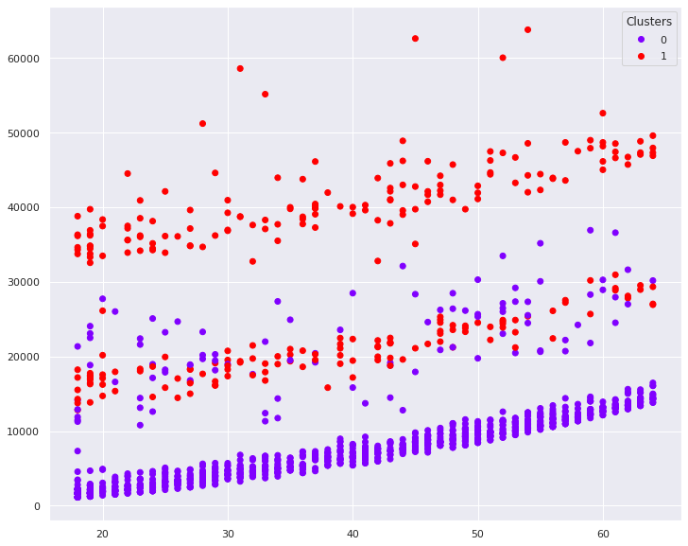
GMM Clustering - 300_iter
0: [36, 6296]
1: [40, 40761]
2: [45, 18505]
1: [3.9 7047]
0: [3.8 29368]]

Slide 17
1: [3.9 7047]
0: [3.8 29368]]

Slide 18
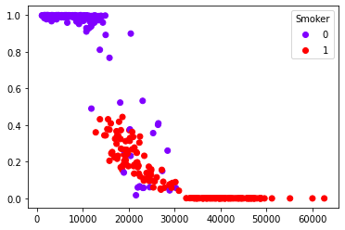
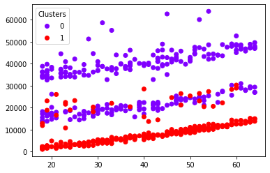
Logistic Regression & GMM Model-
Predict Smoker/Non-Smoker
[-0.0655244 , 0.0863435 , -0.19792367, -0.08792067, 0.36826806, 0.00040367]
The Training Accuracy is: 0.954
The Testing Accuracy is: 0.954
The Training Accuracy is: 0.771
The Testing Accuracy is: 0.704

Slide 19
Results
 | R^2 Score | Mean Absolute Error | Mean Squared Error | Features
Linear Regression | 0.04, 0.11 | 12626.98, 12021.34 | 211253607.93, 194873962.16 | Age, BMI, Smoker
Polynomial Regression | 0.98 | 412.32 | 566326.94 | Age, BMI, Smoker
Random Forest Regression | 0.8166825 | 3475.61 | 25532514.61 | All features

Slide 20
Conclusion
Linear Regression Model R^2 = 0.98
Efficient but
underfitting
Random Forest Model R^2 = 0.81,
lower performance
less likely to suffer from fitting issues
Logistic Regression & Clustering
A Significant Positive Correlation between Smoking and High Medical Cost was Observed

